Slide 1
Intro to Machine Learning
Workshop 1

Slide 2

Agenda
Please Sign-In!
Define machine learning
Define supervised learning
Examine linear regression
Linear regression code example
Summary
Suggest next learning steps

Slide 3
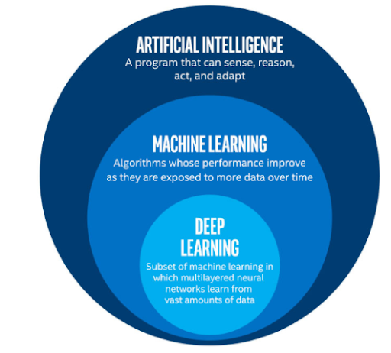
What is Machine Learning?
Machine learning definition: The use and development of computer systems that can learn and adapt without following explicit instructions, by using algorithms and statistical models to analyze and draw inferences from patterns in data.
There are 4 learning methods in machine learning
Supervised Learning
Unsupervised Learning
Semi Supervised Learning
Reinforcement Learning

Slide 4
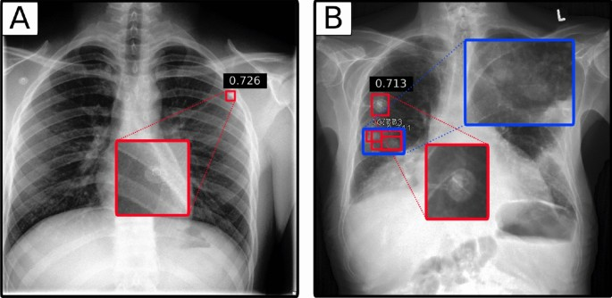
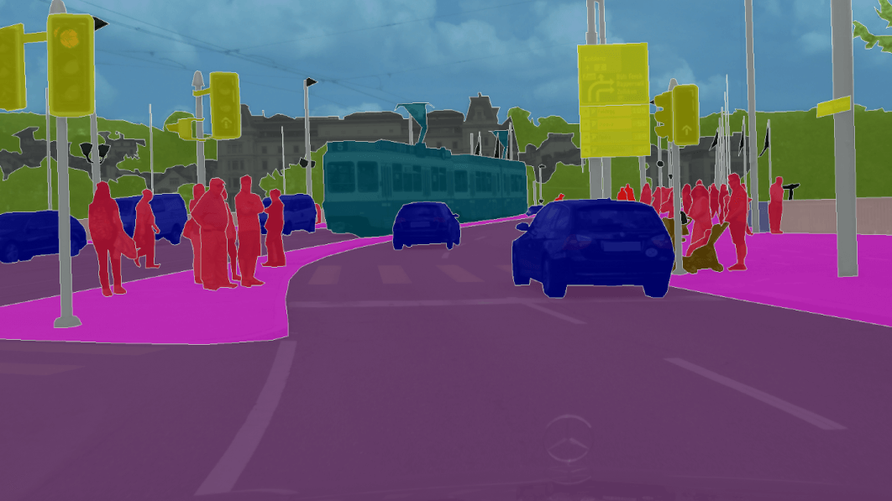
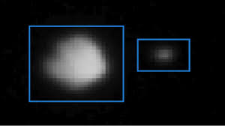
Why learn machine learning?
Its applications are endless!
Autonomous Vehicles
Medical Imaging
Aerospace
Natural Language Processing
Stock Market Prediction

Slide 5
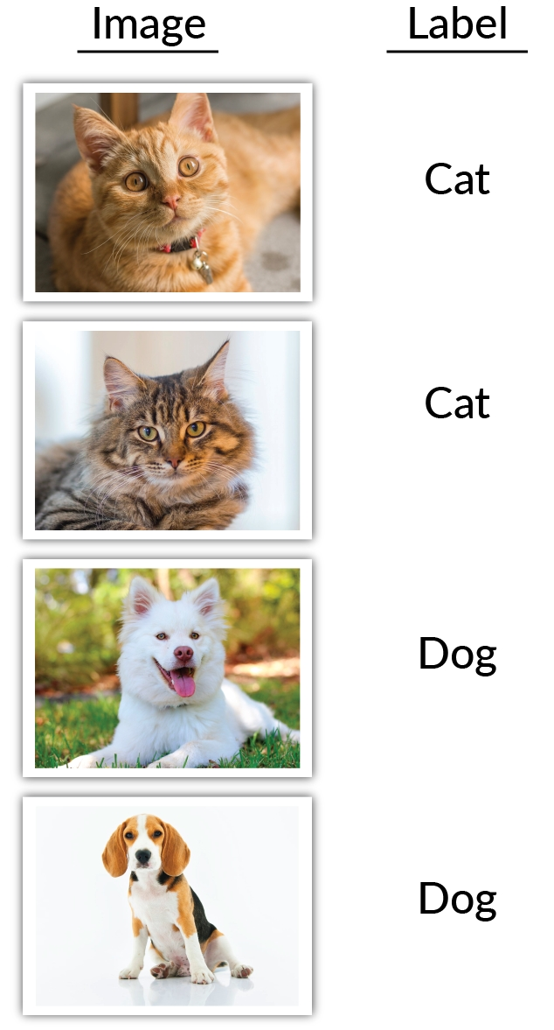
Supervised Learning
The type of learning refers to how the algorithm is optimized
In supervised learning the algorithm is optimized with labels. The labels let the algorithm know if the output they predicted was correct or not
For this workshop, we will only work with supervised learning models

Slide 6
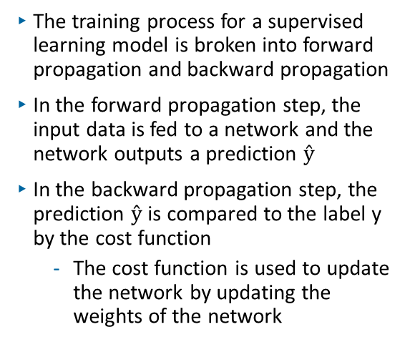
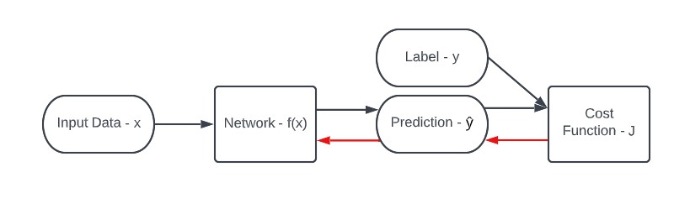
Supervised Learning Cont.

Slide 7
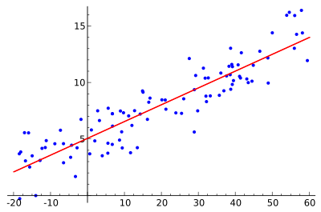
Linear Regression
Linear regression is a supervised learning model that assumes a linear relationship between the input variables and the single output variable

Slide 8
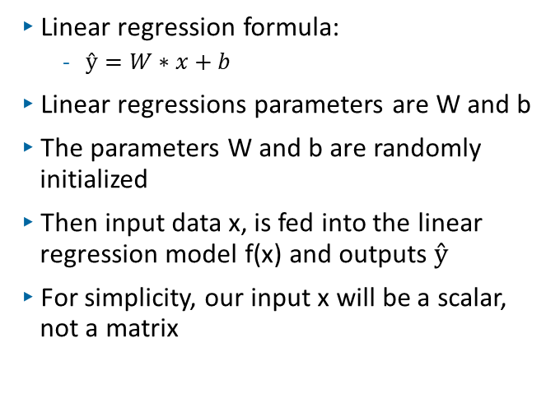
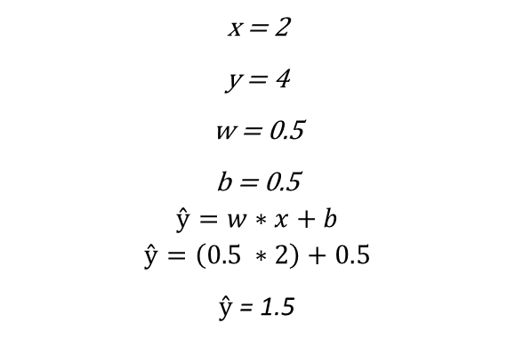
Linear Regression: Forward Propagation

Slide 9
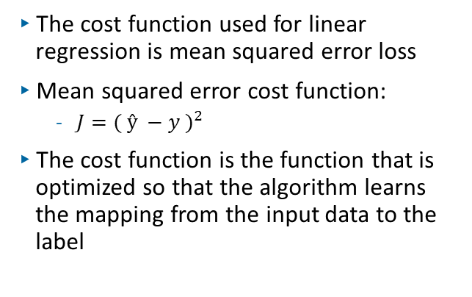
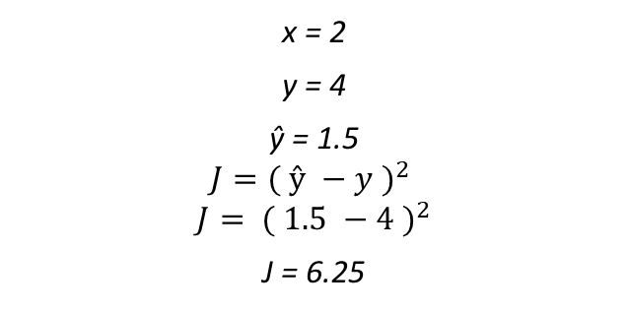
Linear Regression: Backward Prop. Cost function

Slide 10
Linear Regression: Backward Prop. Cost Function Cont.

Slide 11
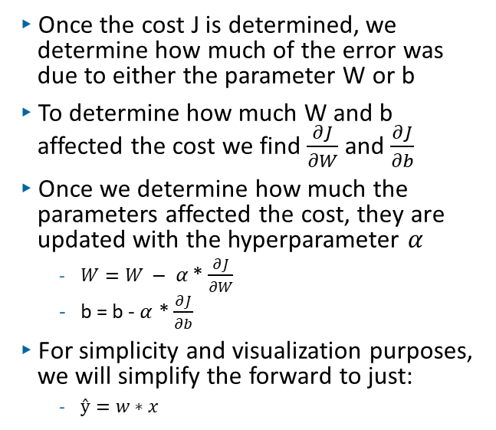

Linear Regression: Backward Prop. Gradient Descent

Slide 12
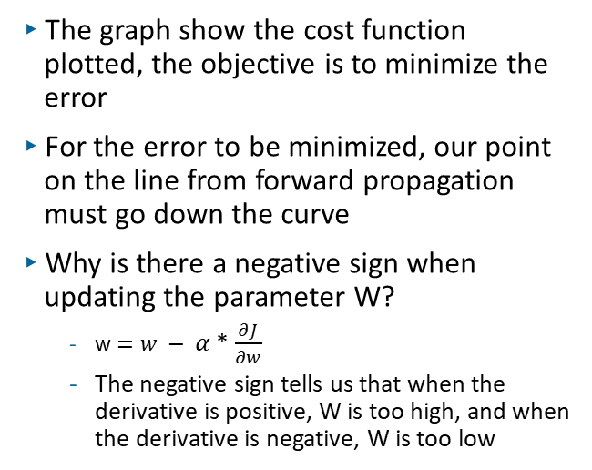
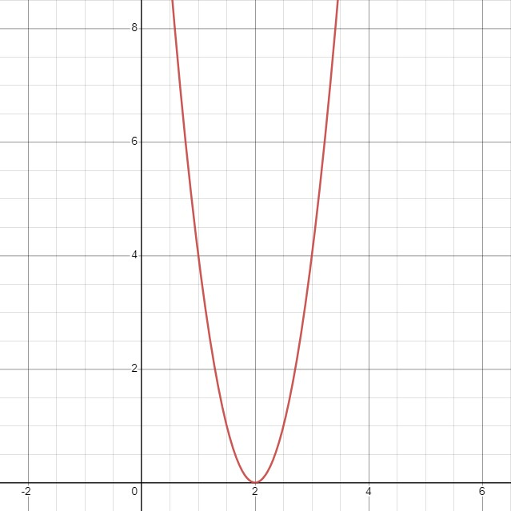
Linear Regression: Backward Prop. Gradient Descent Cont.

Slide 13
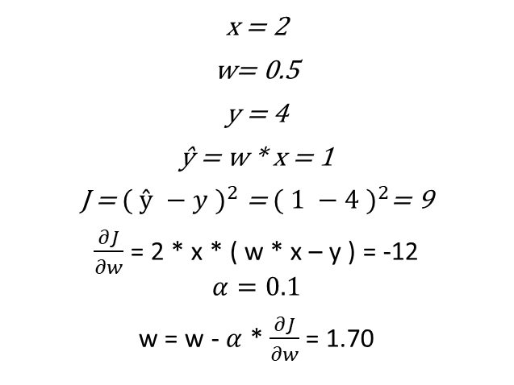
Linear Regression: Backward Prop. Gradient Des. Step 1

Slide 14
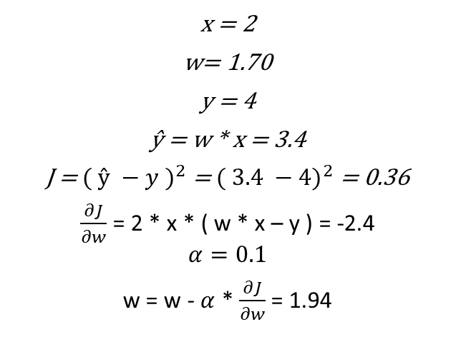
Linear Regression: Backward Prop. Gradient Des. Step 2

Slide 15
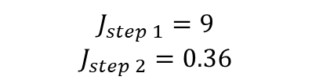
Linear Regression: Backward Prop. Gradient Des. Sum.

Slide 16
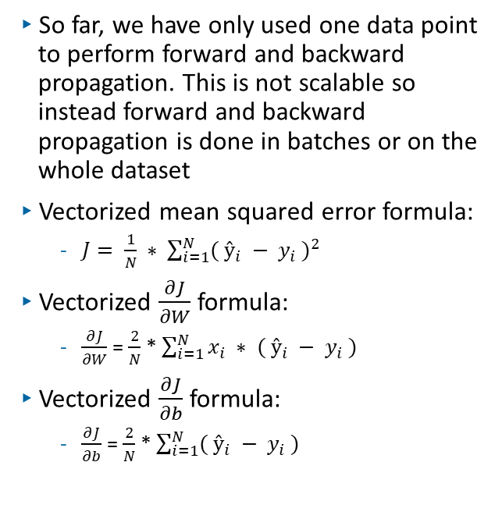
Linear Regression: Vectorization

Slide 17
Code Example
Click to load up todays coding example follow along for the code example, no installations are required, it is done using Google Collaboratory

Slide 18
Summary
Defined machine learning
Defined supervised learning
Examined linear regression
Forward propagation
Backward propagation
Mean squared error
Gradient descent
Vectorization
Linear regression code example

Slide 19
What’s next?
Future IEEE machine learning workshops, click on the link to sign up
Week 2: Multiple Neuron Network
Week 3: Deep Learning and PyTorch
Week 4: Computer Vision and Network Tuning
Week 5: Transfer Learning and Age Predictor App
Recommended readings
The Hundred-Page Machine Learning Book
Recommend online courses
Deeplearninig.ai by Andrew Ng
freeCodeCamp.org

Slide 20

IEEE UH Github
This is the link to the IEEE University of Houston Github
Access to this workshop’s code key
Access to all other IEEE workshops code

